Slide 1
KBB Transport Ltd.
A Brief Introduction

Slide 2
KBB Transport Ltd. specializes in providing a full rage of logistics services, via all transport modes, including turnkey domestic and global point to point transport solutions as well as encompassing the ancillary services of feasibility and route studies, risk management, asset protection and banking. The many years of global project and heavy lift transport experience that our team possesses serves well to provide our colleagues and clientele with first class project, heavy lift and dimensional freight forwarding logistics solutions on a domestic North American and global basis.
Please feel free to call or send along your enquiries that could benefit from our particular skill set
The solutions we provide combined with our transport management allow our cliental to successfully maintain budgets, time-lines and logistics requirements.
KBB Transport Ltd continuously strives to provide the utmost in one-stop logistics services to our clientele.

Slide 3
Services: Site to Site Heavy Lift & Project Transport
From Site to FAS
Delivered to Site
Vessel Discharge at Destination
Vessel Discharge
From FCA loaded on Transport
Site to Under vessels Hook
To Delivered Free on Transport
To Final Site

Slide 4
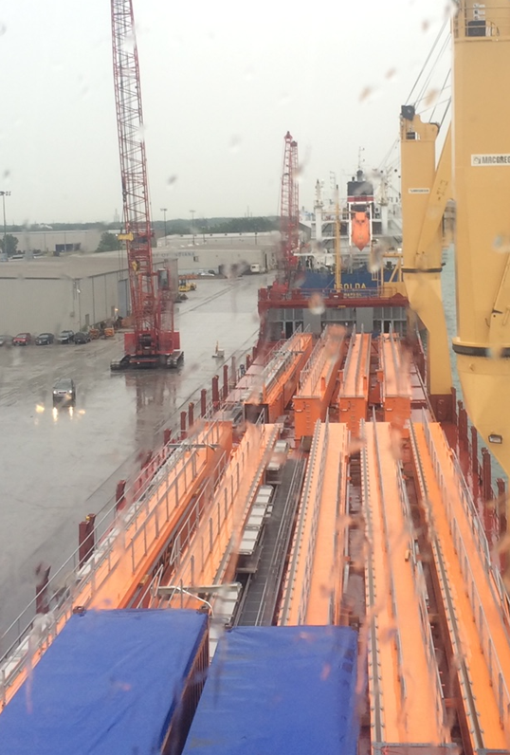
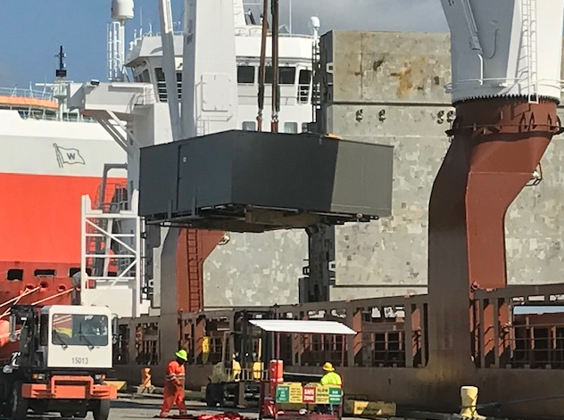
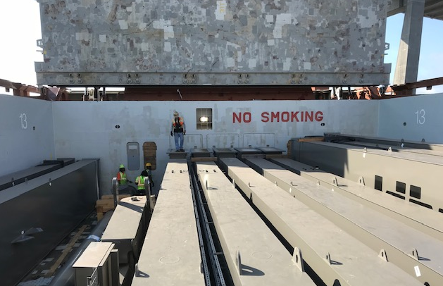
Marine charter and terminal services
Vessel Chartering
Shoreside services
Project Management

Slide 5
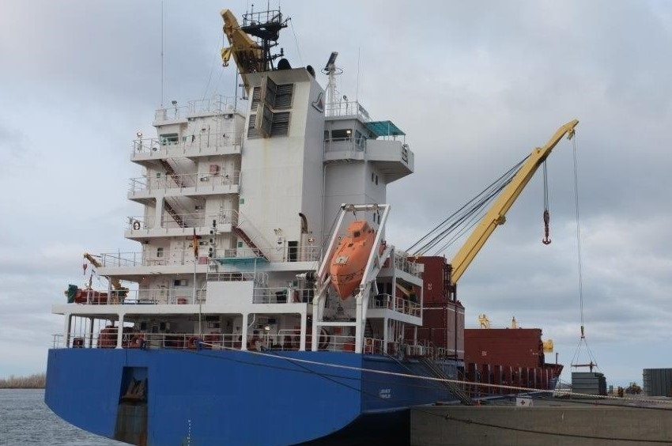
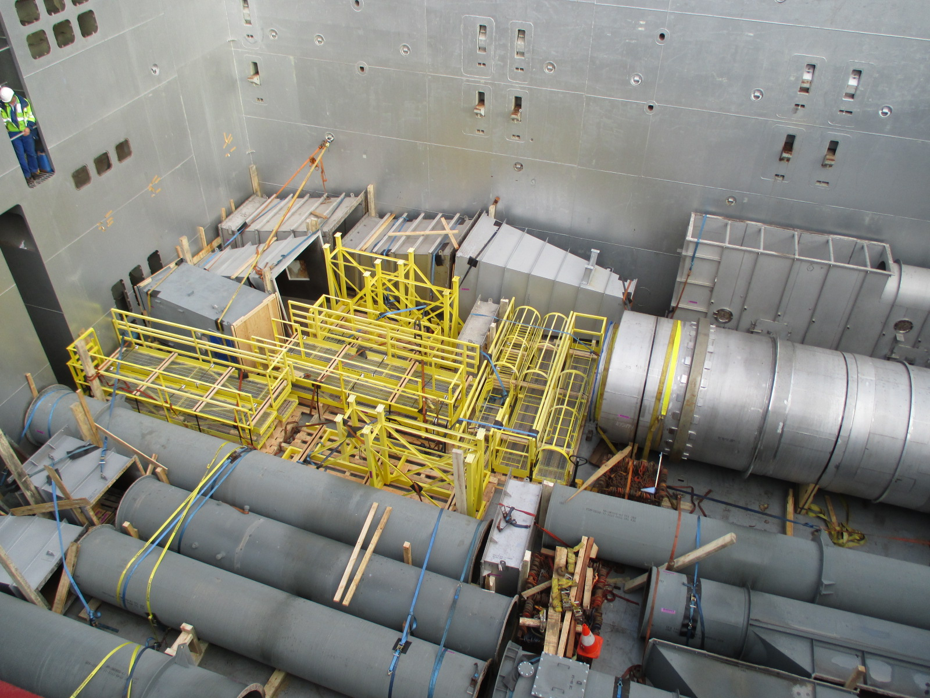
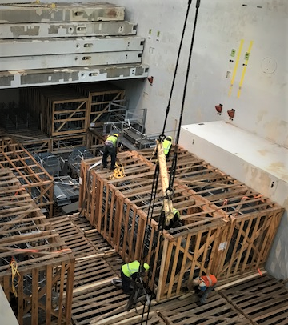
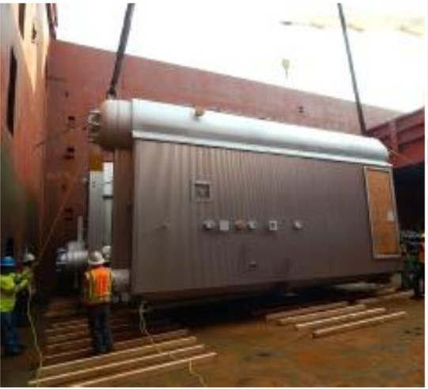
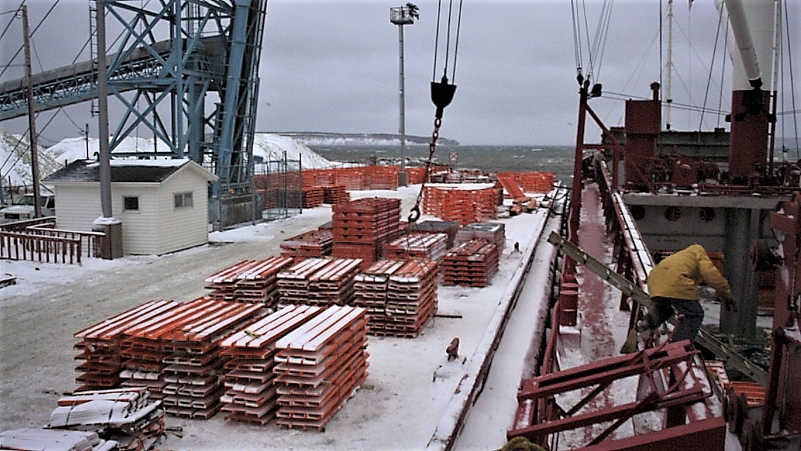
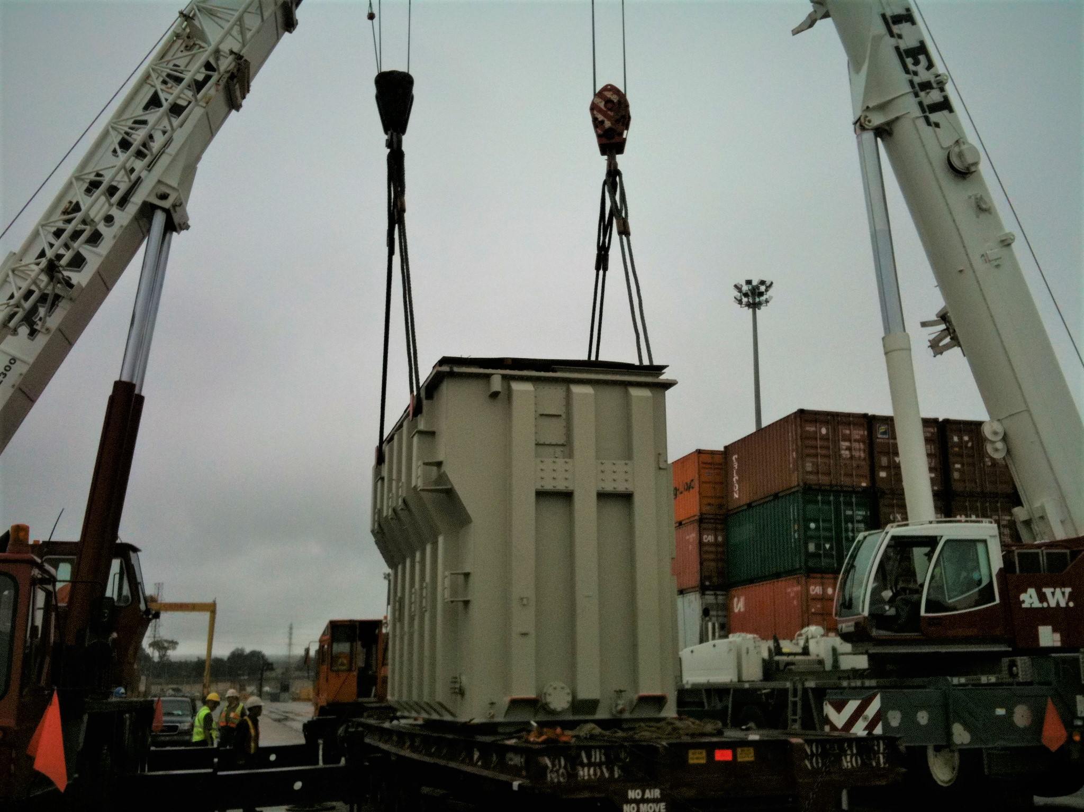
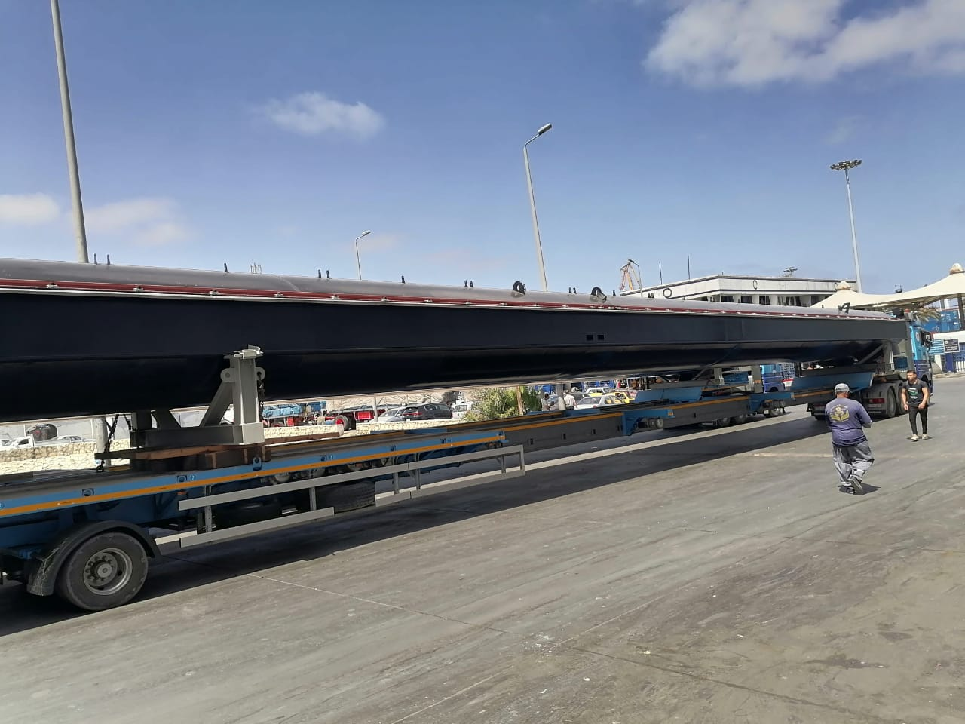
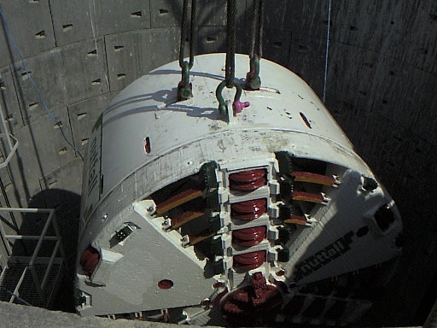
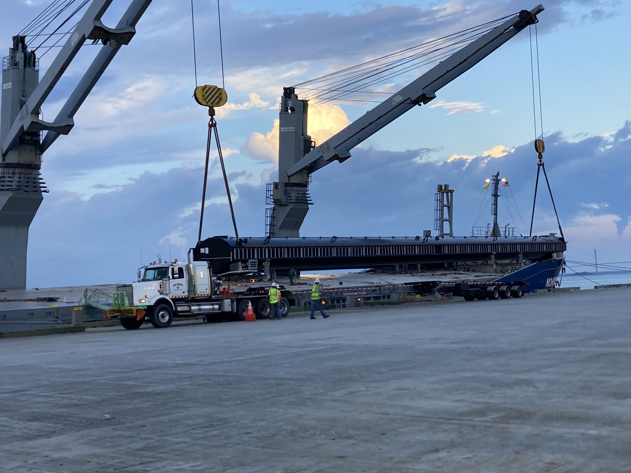
Project and Heavy Lift Transports

Slide 6
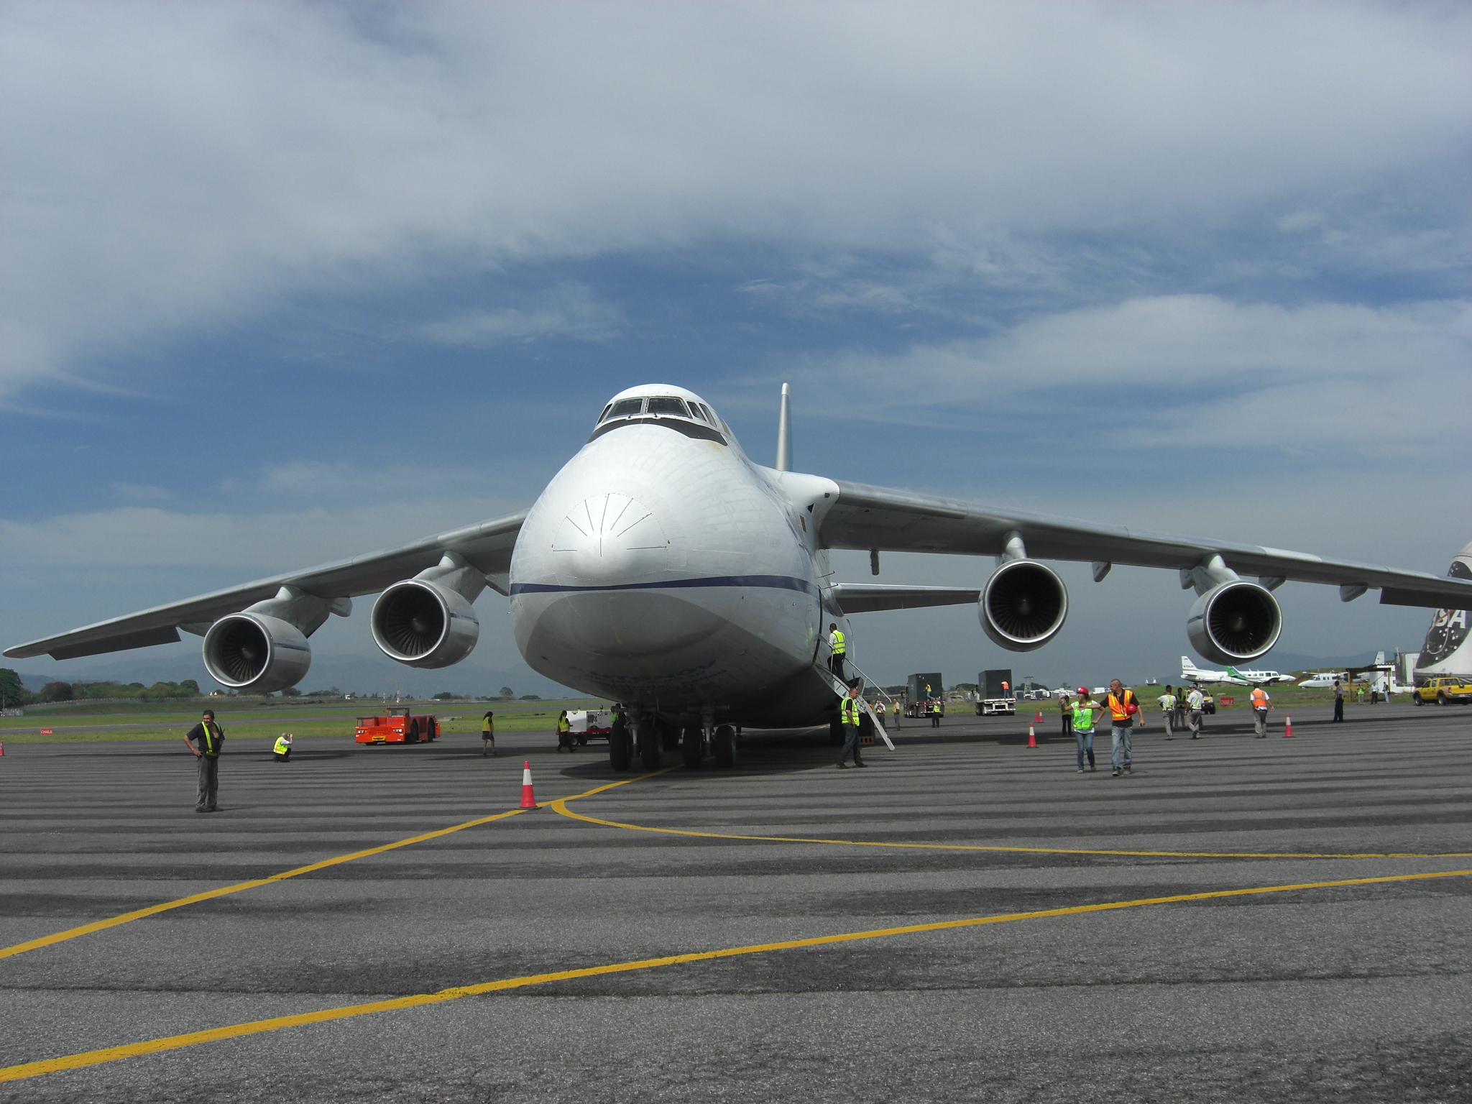
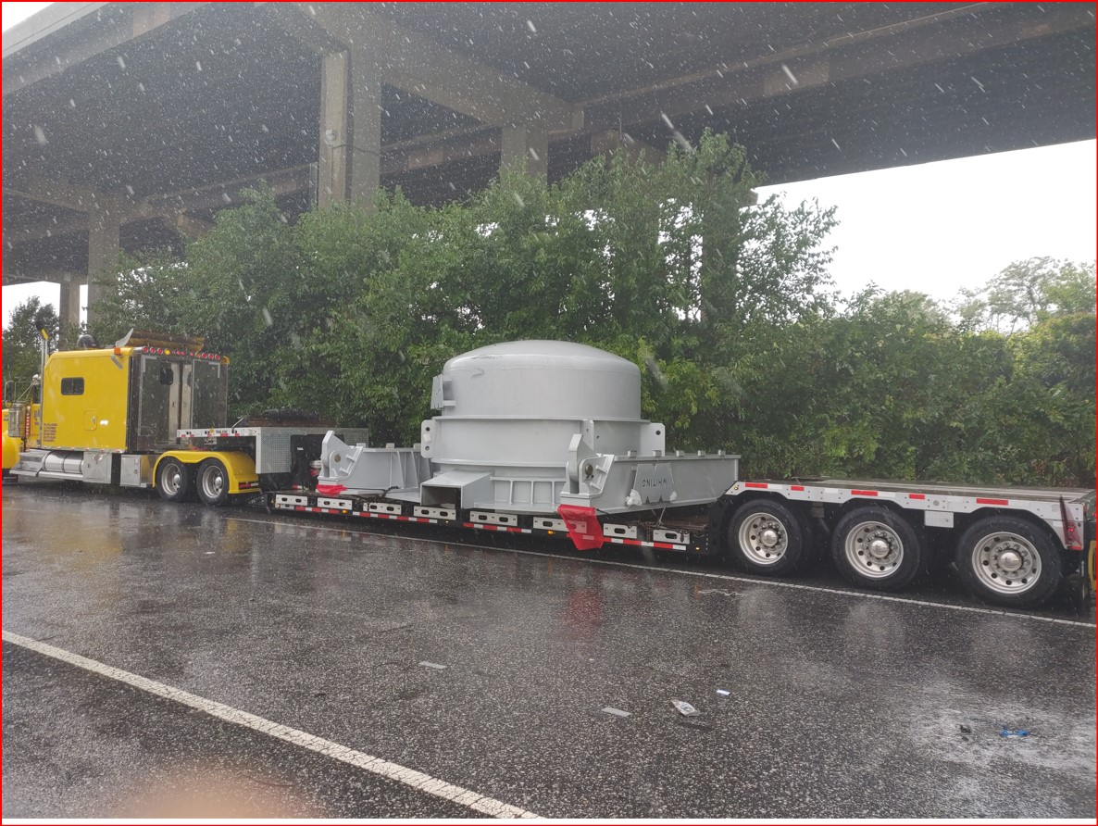
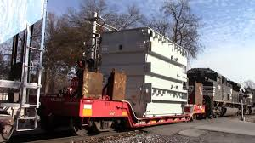
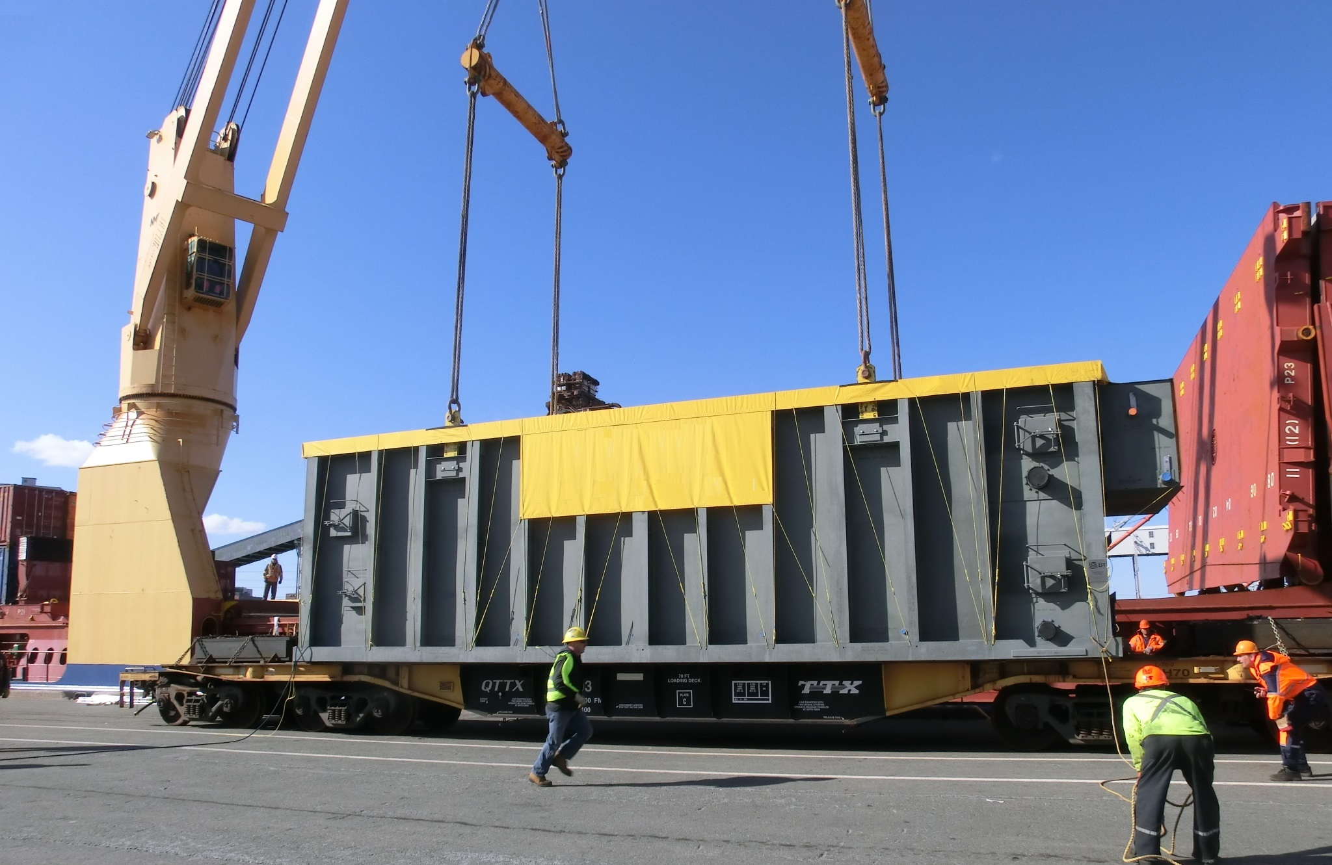
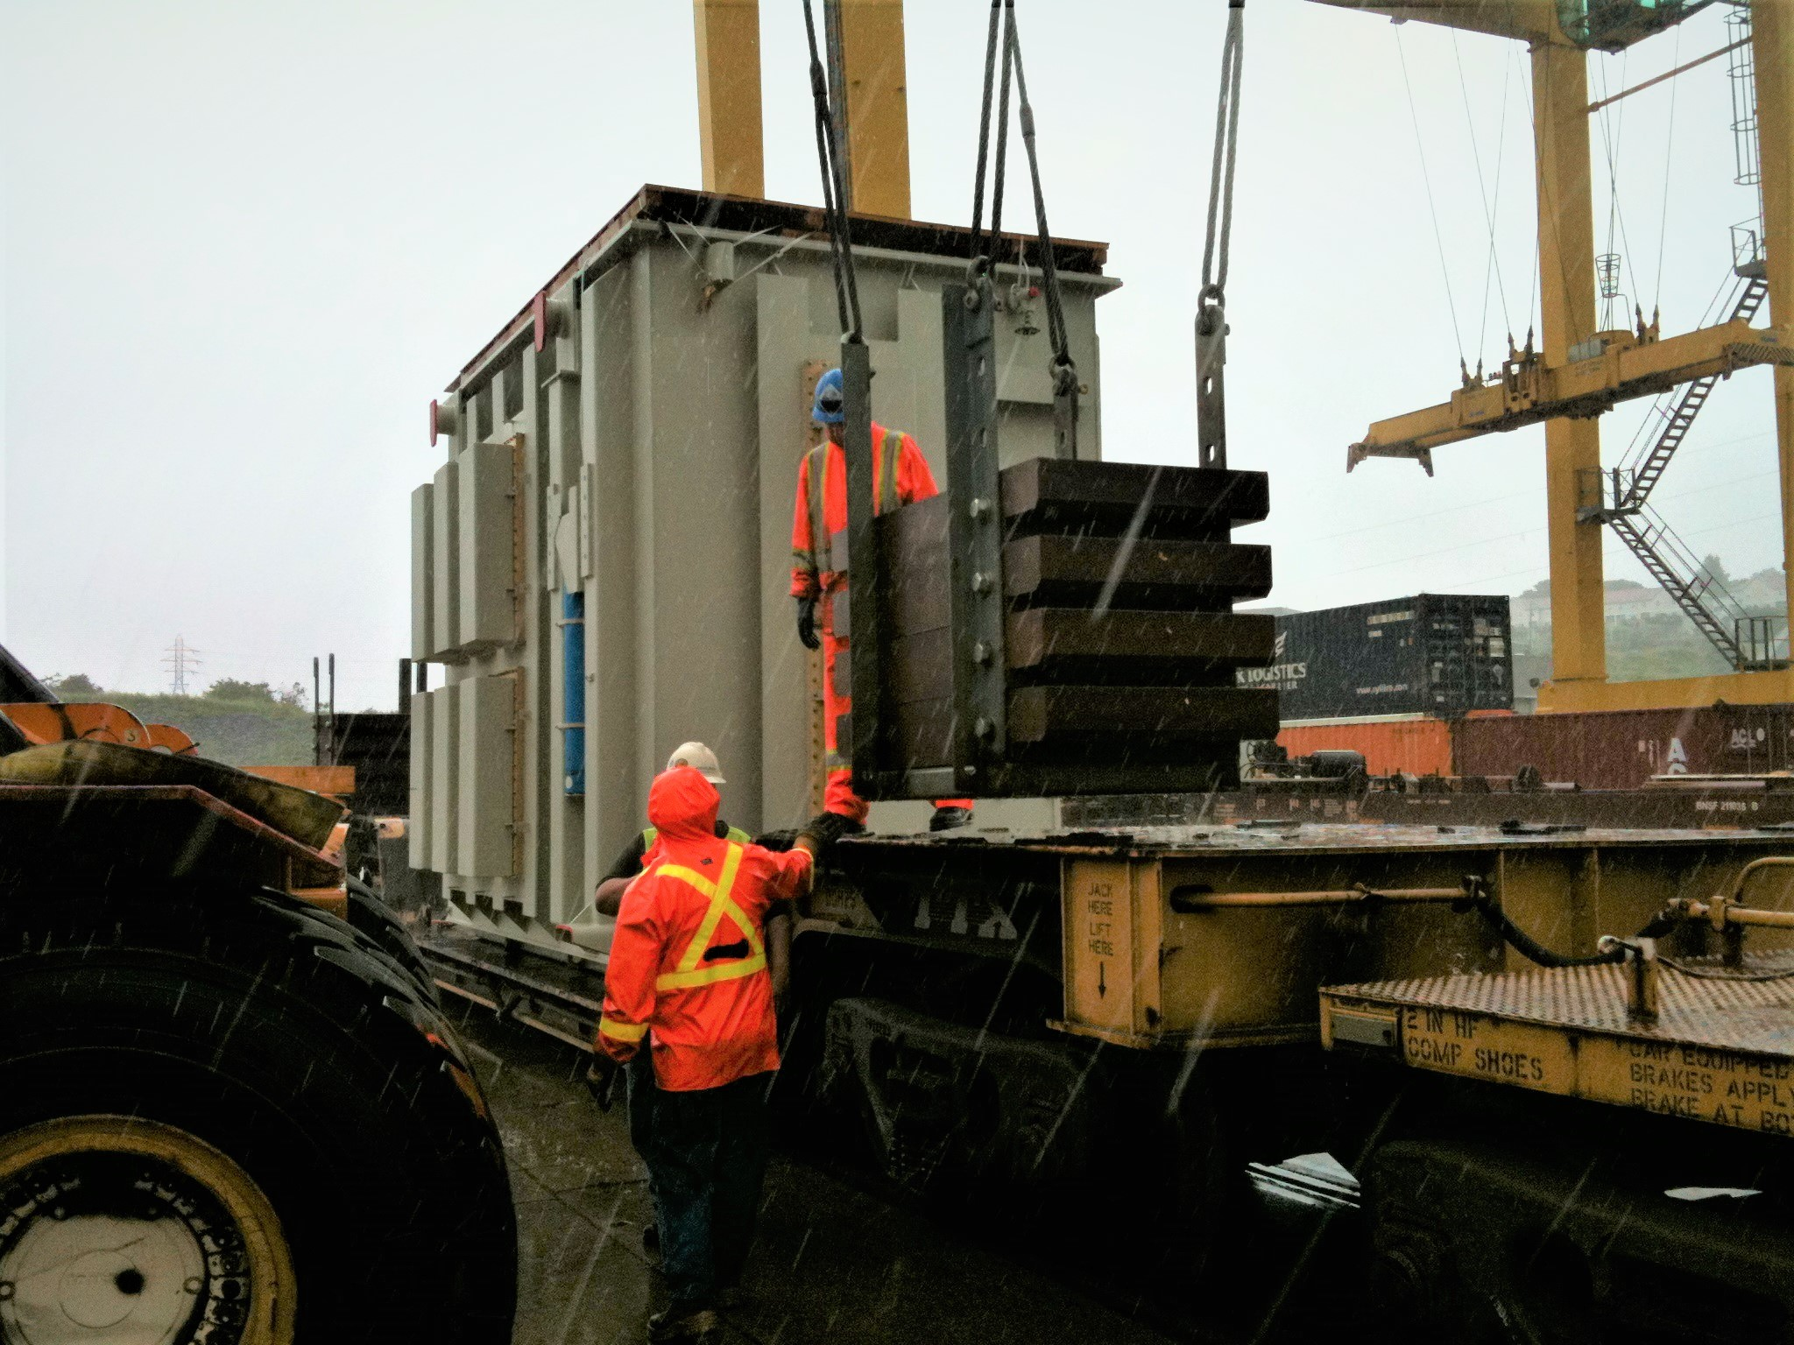
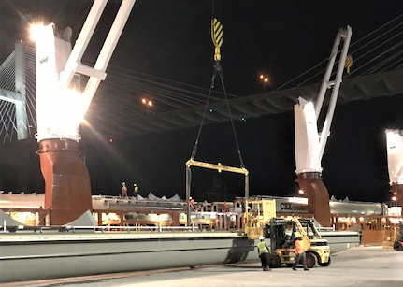
Transport proficiencies via all modes
Notes:
For additional details, Please contact
KBB Transport Ltd.
Don Kinsella PH: +1 416-807-1699 email dkinsella@kbbtransport.com

Slide 7
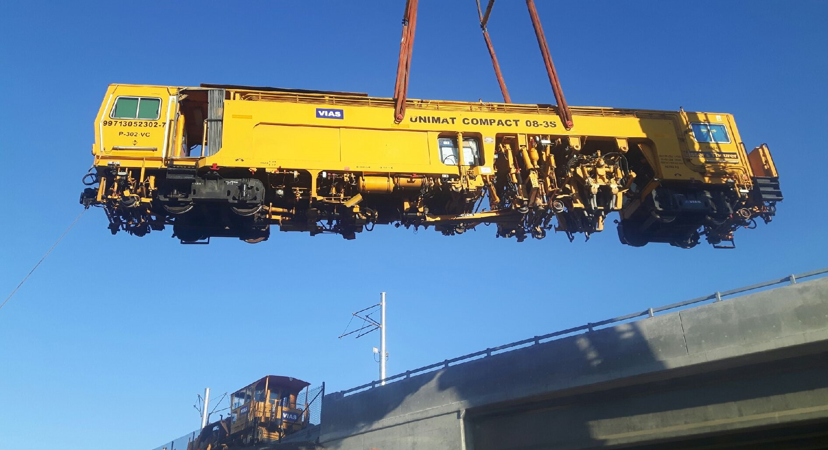
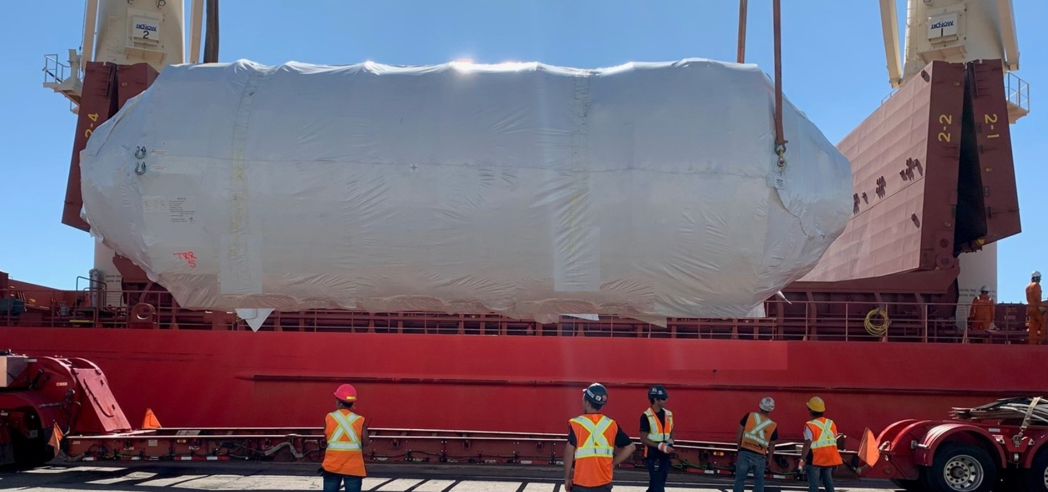
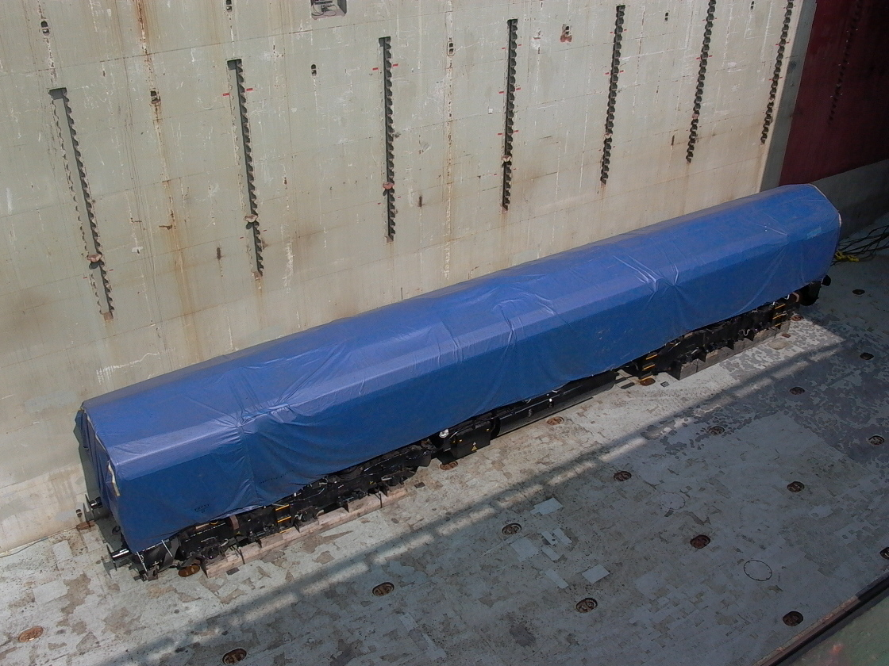
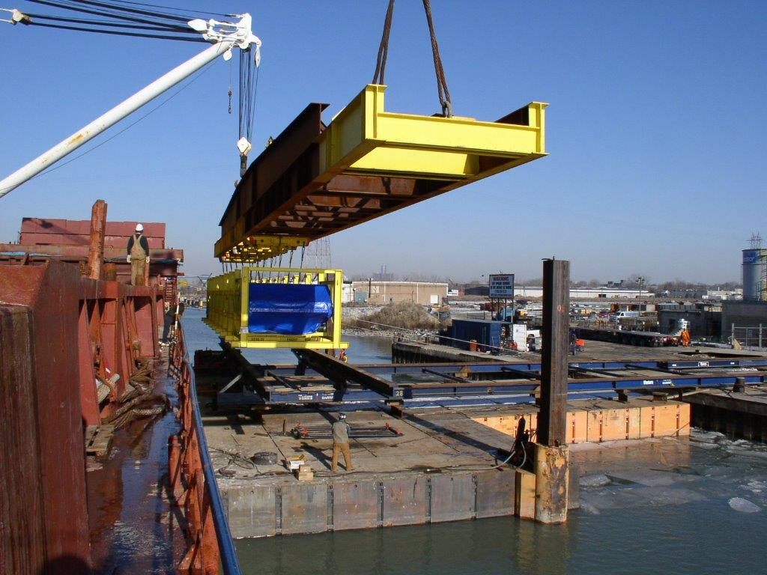
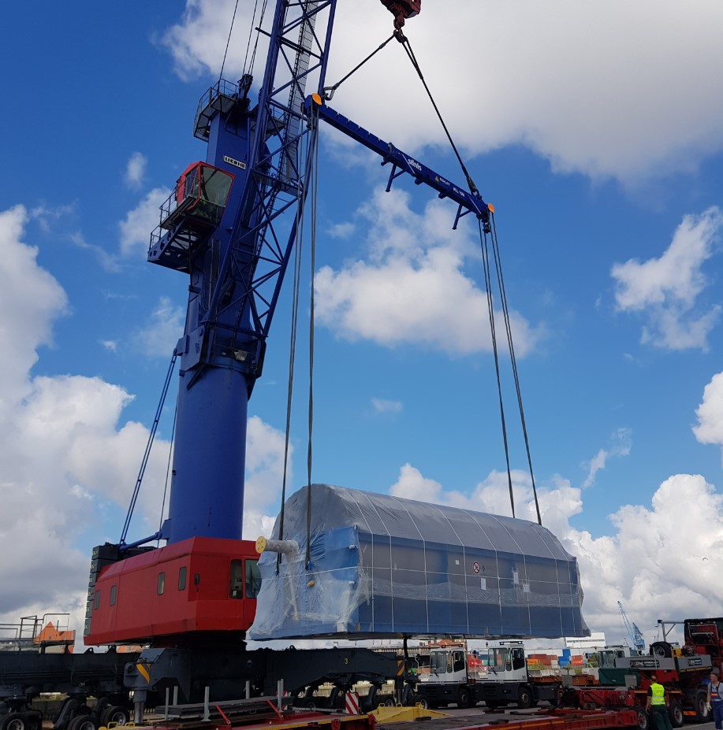
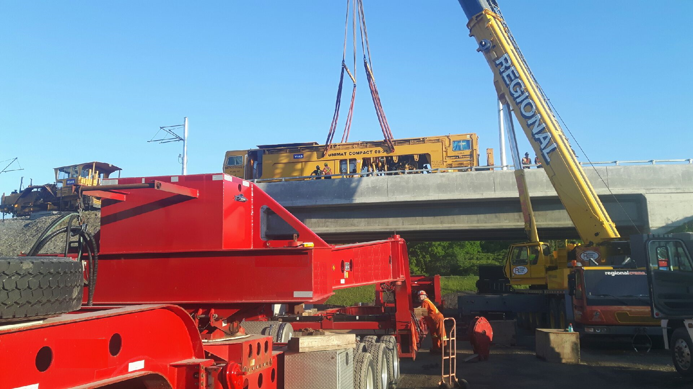
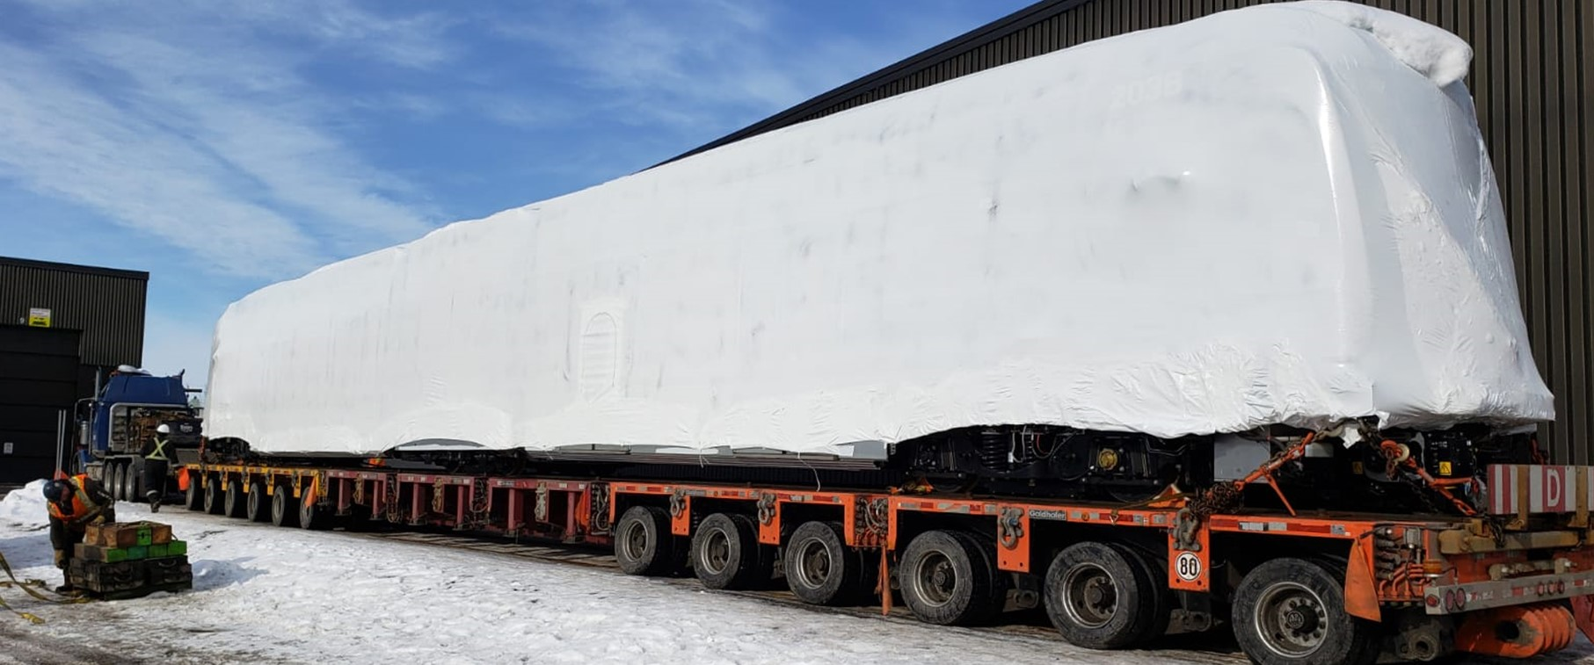
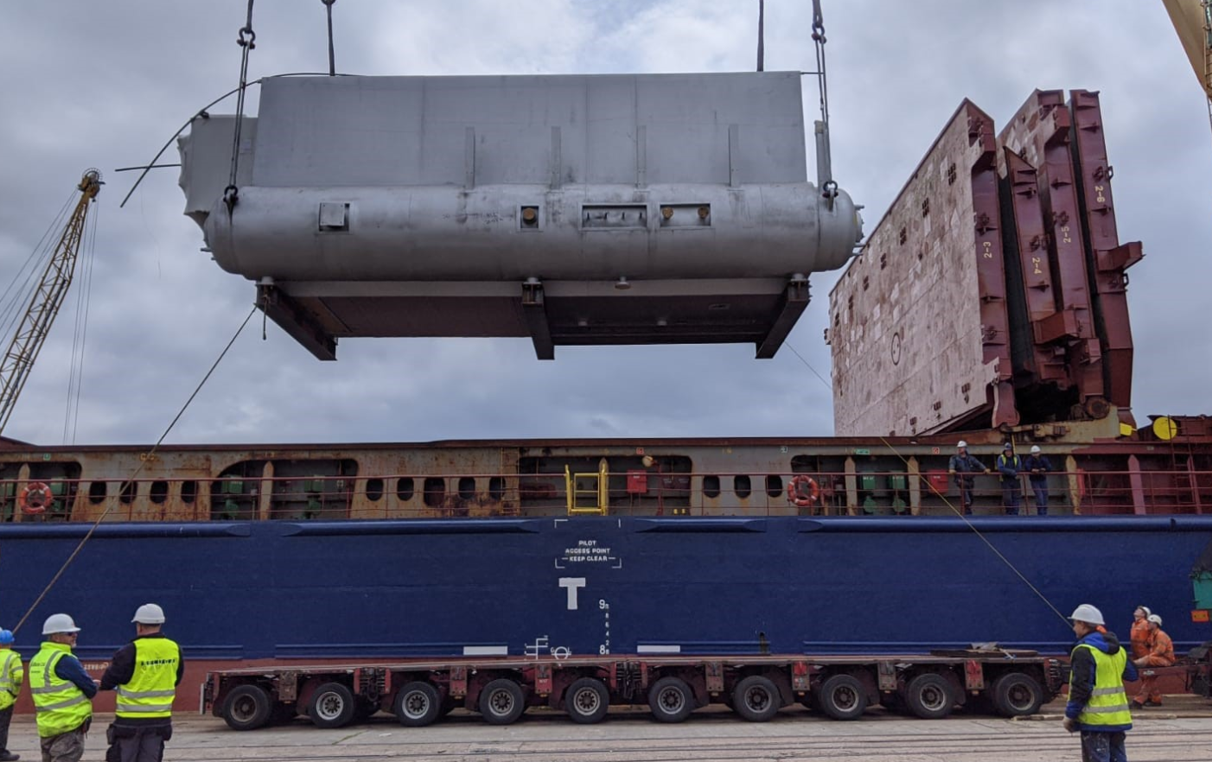
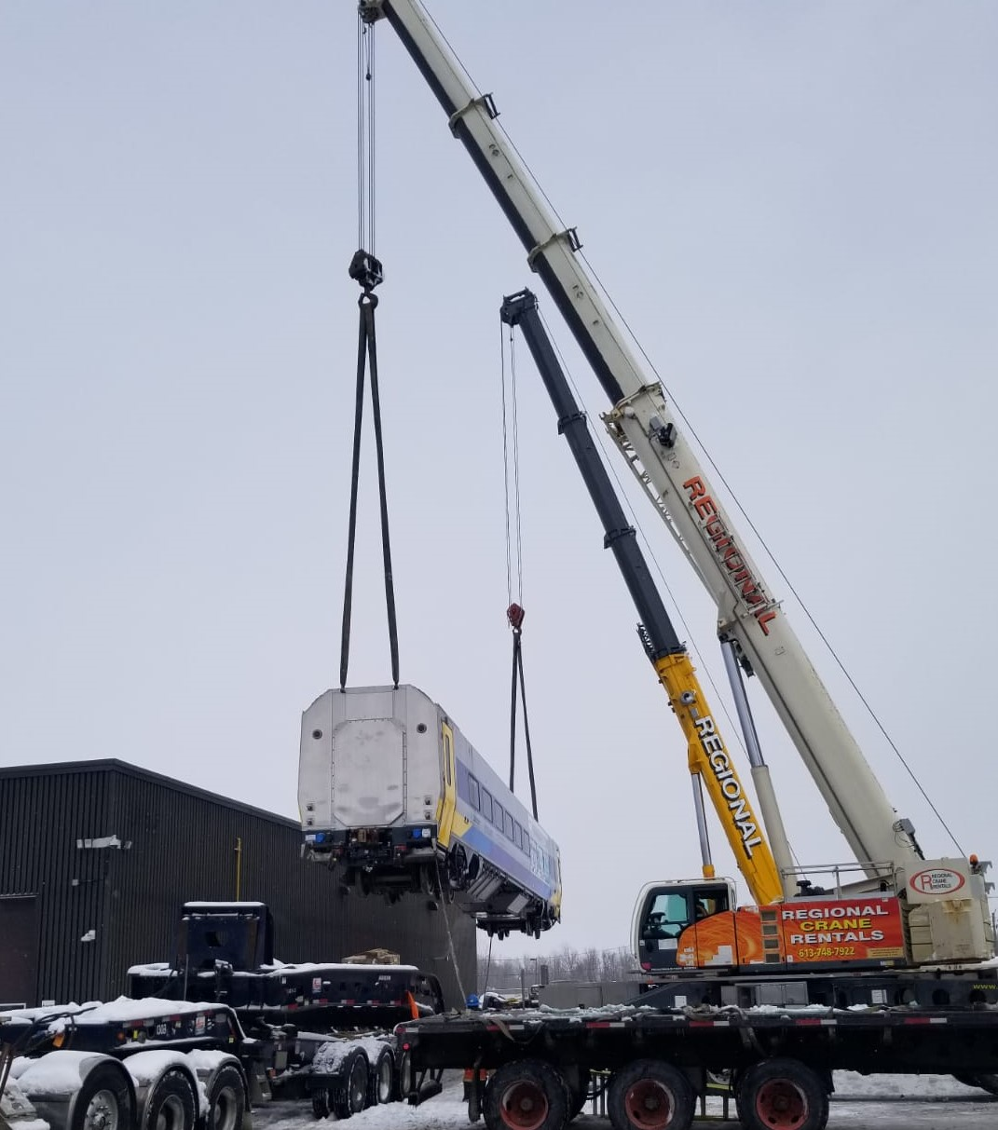
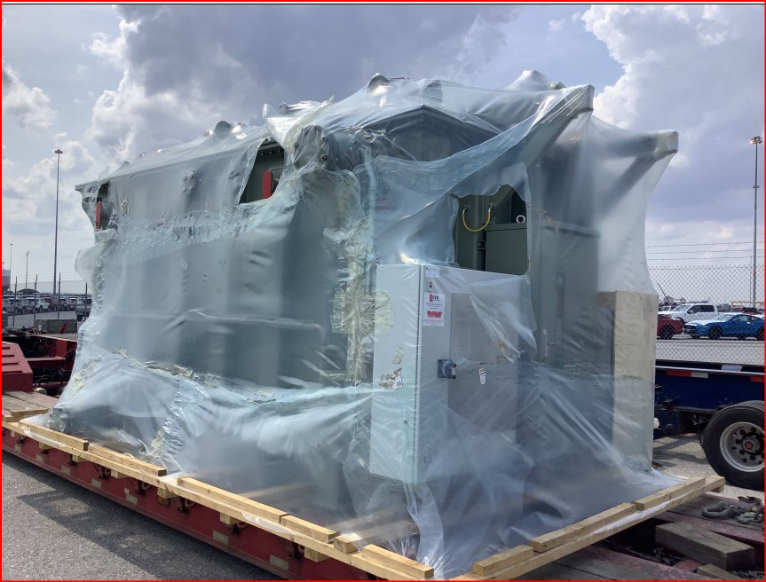
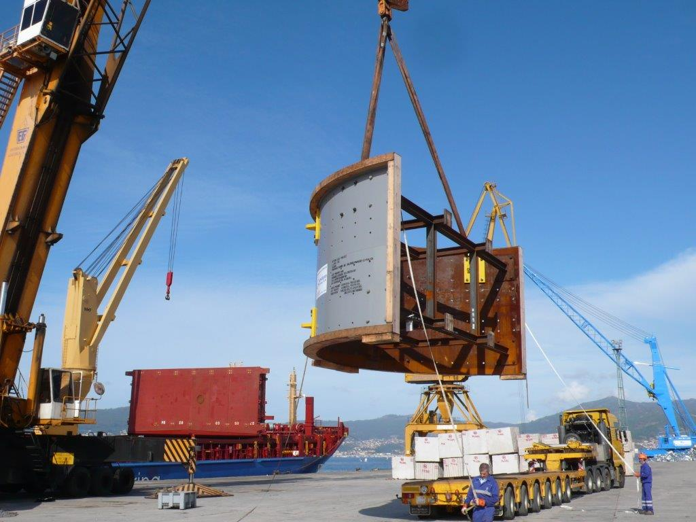
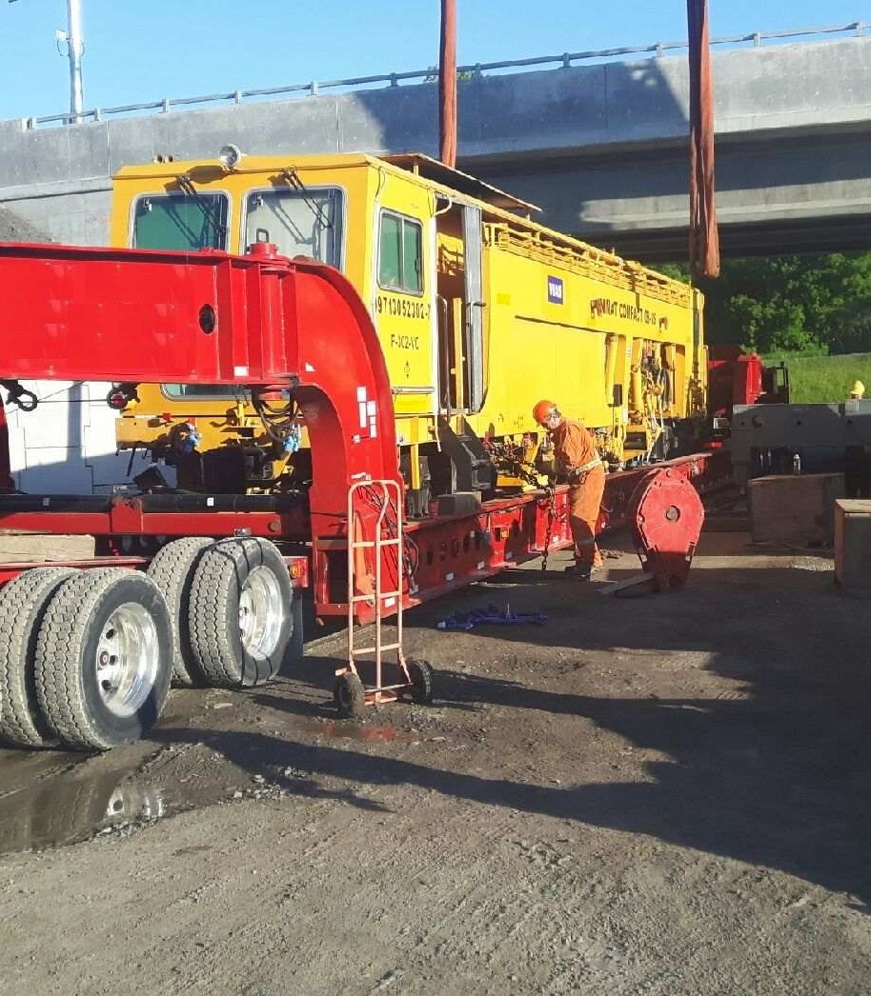
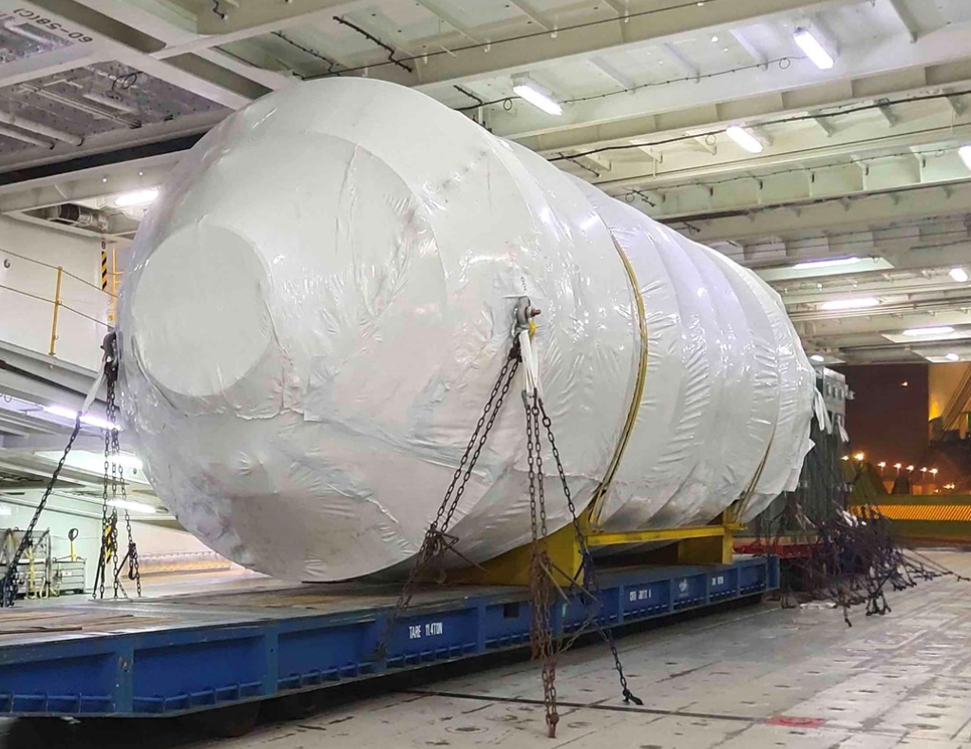
Project Rail and Heavy Lift Transports

Slide 8
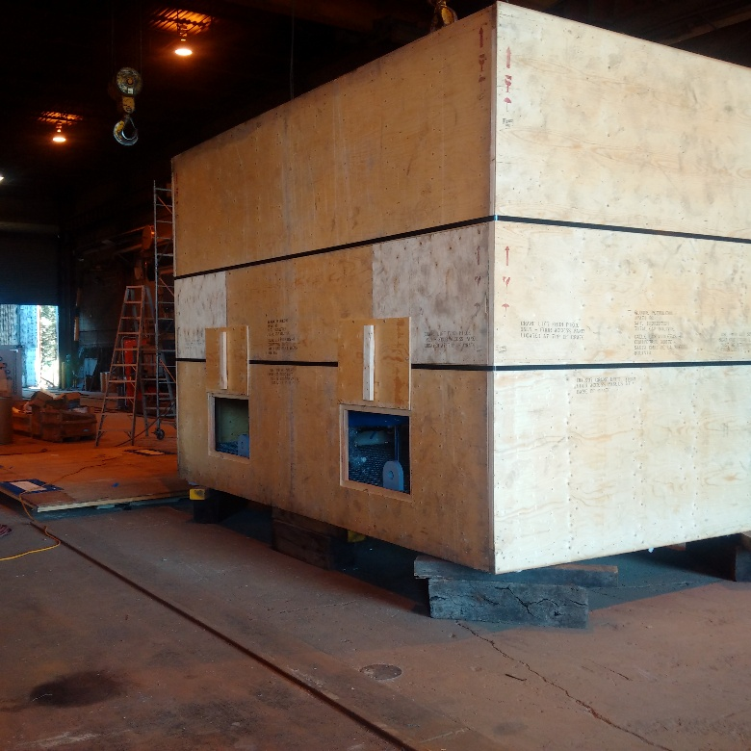
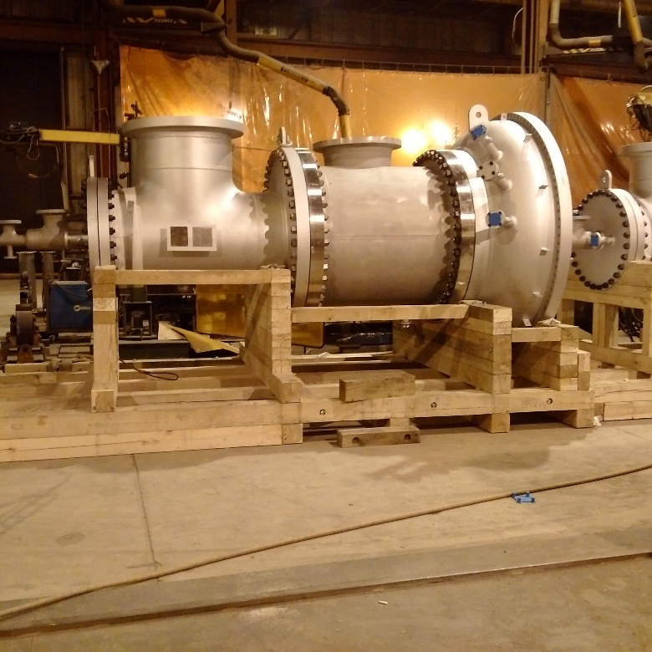
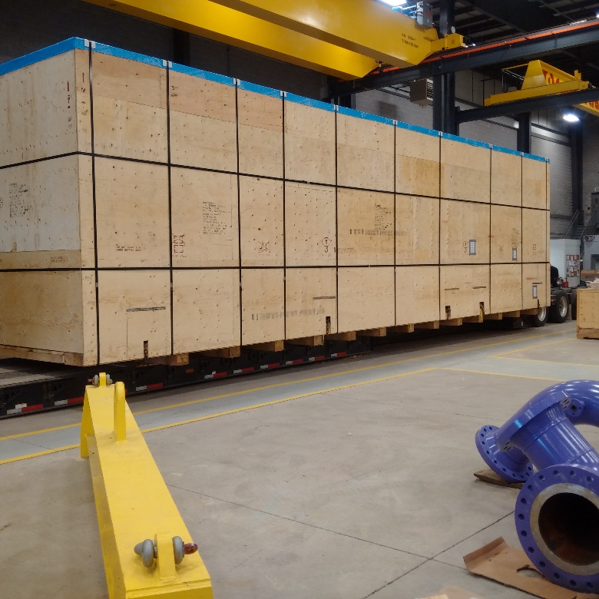
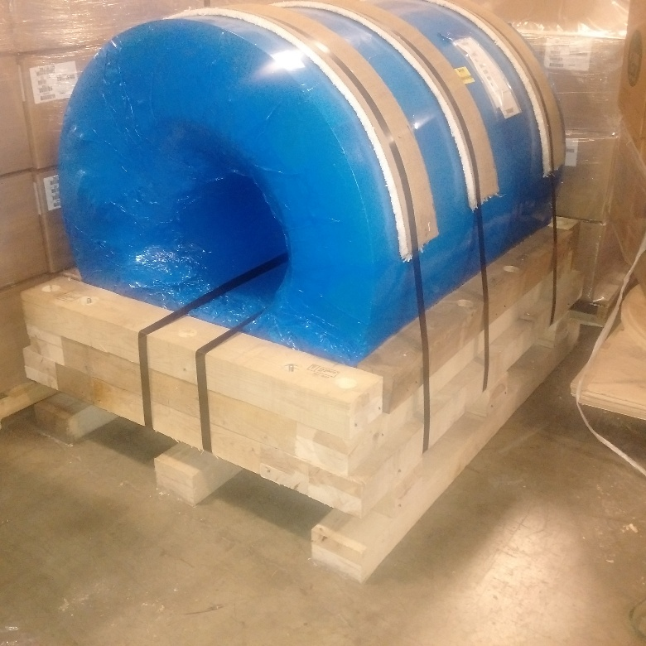
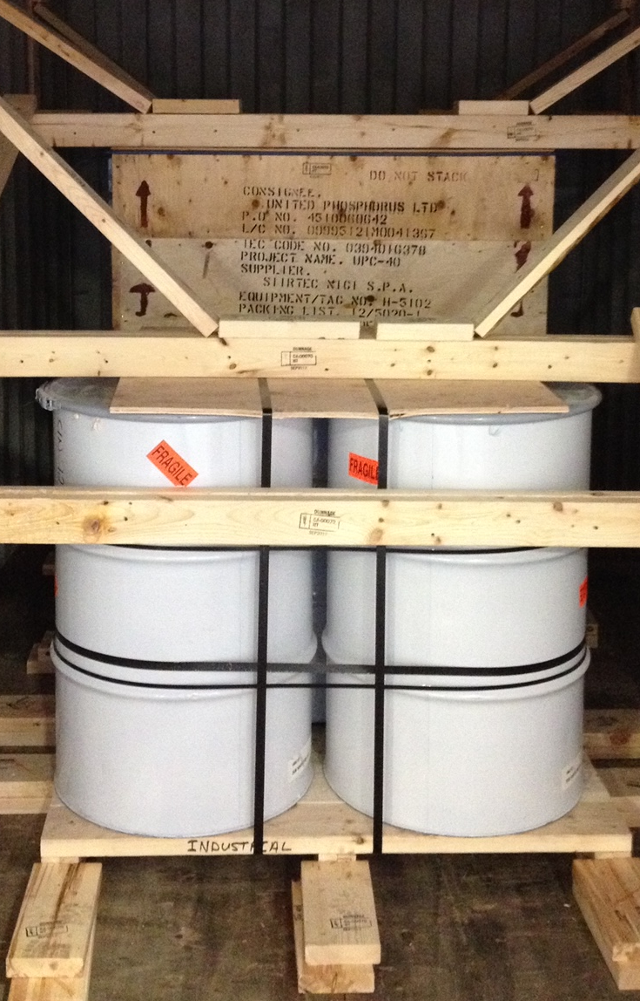
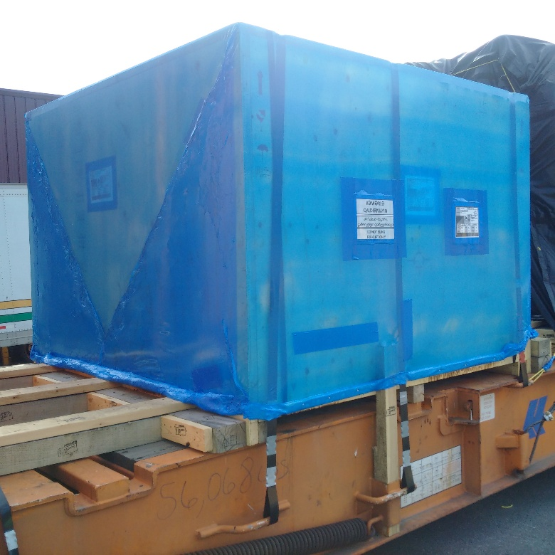
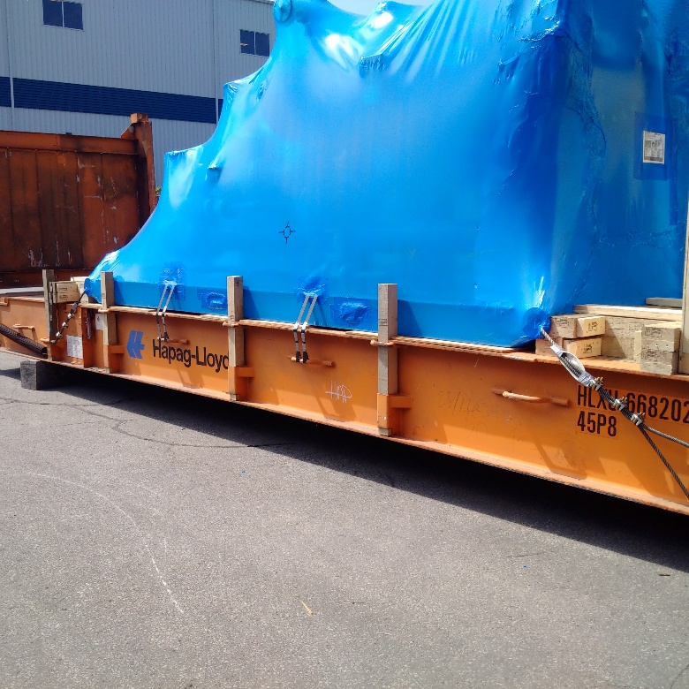
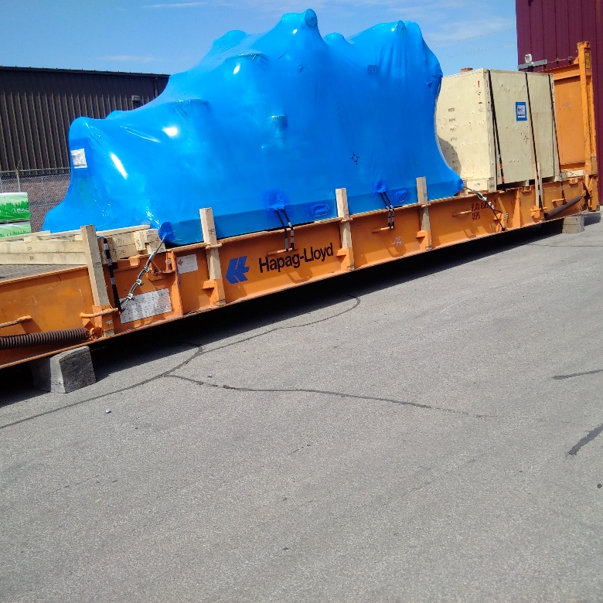
Asset Protection
Notes:
A variety of asset protection solutions can be provided, Also with service for container blocking and bracing and customs crating

Slide 9
Contact KBB Transport Ltd.
Donald Kinsella www.kbbtransport.com
For further information on how we will provide transport solutions to meet your requirements,
Contact KBB Transport Ltd:

